Slide 1
TORRY HARRIS Railway Reservation System Presented by Team-4 Pratyush Srivastava Praveen Parihar Priyanka thorat Neeraj Kumar Rakesh Ranjan

Slide 2
Project Backend Made By Pratyush Srivastava Praveen Parihar
Backend Contents
1.Mysql Database
2.Bean Classes
3.Database Layer(Connection , Sending & Receiving Of Data)
4.Server layer(Servlets)

Slide 3
JAVA BEAN CLASSES Java beans incorporate a set of objects into one accessible object that can be accessed easily from any application. This single accessible object is maintainable, customizable, and reusable.

Slide 4
DATABASE LAYER The Data Access Object is basically an object or an interface that provides access to database or any other persistence storage. For example if we want to perform some operation for table “employee” present inside the database interface EmployeeDAO { List<Employee> findById(); boolean insertEmployee(Employee employee); boolean updateEmployee(Employee employee); boolean deleteEmployee(Employee employee); }

Slide 5
server layer Java Servlets are programs that run on a Web or Application server and act as a middle layer between a requests coming from a Web browser or other HTTP client and databases or applications on the HTTP server. Using Servlets, we can take input from user through web page and we can present records from a database or another source, and create dynamic web pages

Slide 6
Front-End & Designing Made by Priyanka thorat Neeraj Kumar Rakesh Ranjan Contents HTml Html code Connectivity Designing Through CSS bootstrap functioned by Java Script

Slide 7
HTML HTML stands for Hyper Text Markup Language HTML is used for creating Web pages HTML describes the structure of a Web page HTML consists of a series of elements HTML elements that tell the browser how to display the content CSS CSS stands for Cascading Style Sheets CSS describes how HTML elements are to be displayed on screen, paper, or in other media CSS is the language we use to style an HTML document. JAVA SCRIPT JavaScript is a light-weight object-oriented programming language which is used by several websites for scripting the webpages. It is an interpreted programming language that enables dynamic interactivity on websites when applied to an HTML document

Slide 8
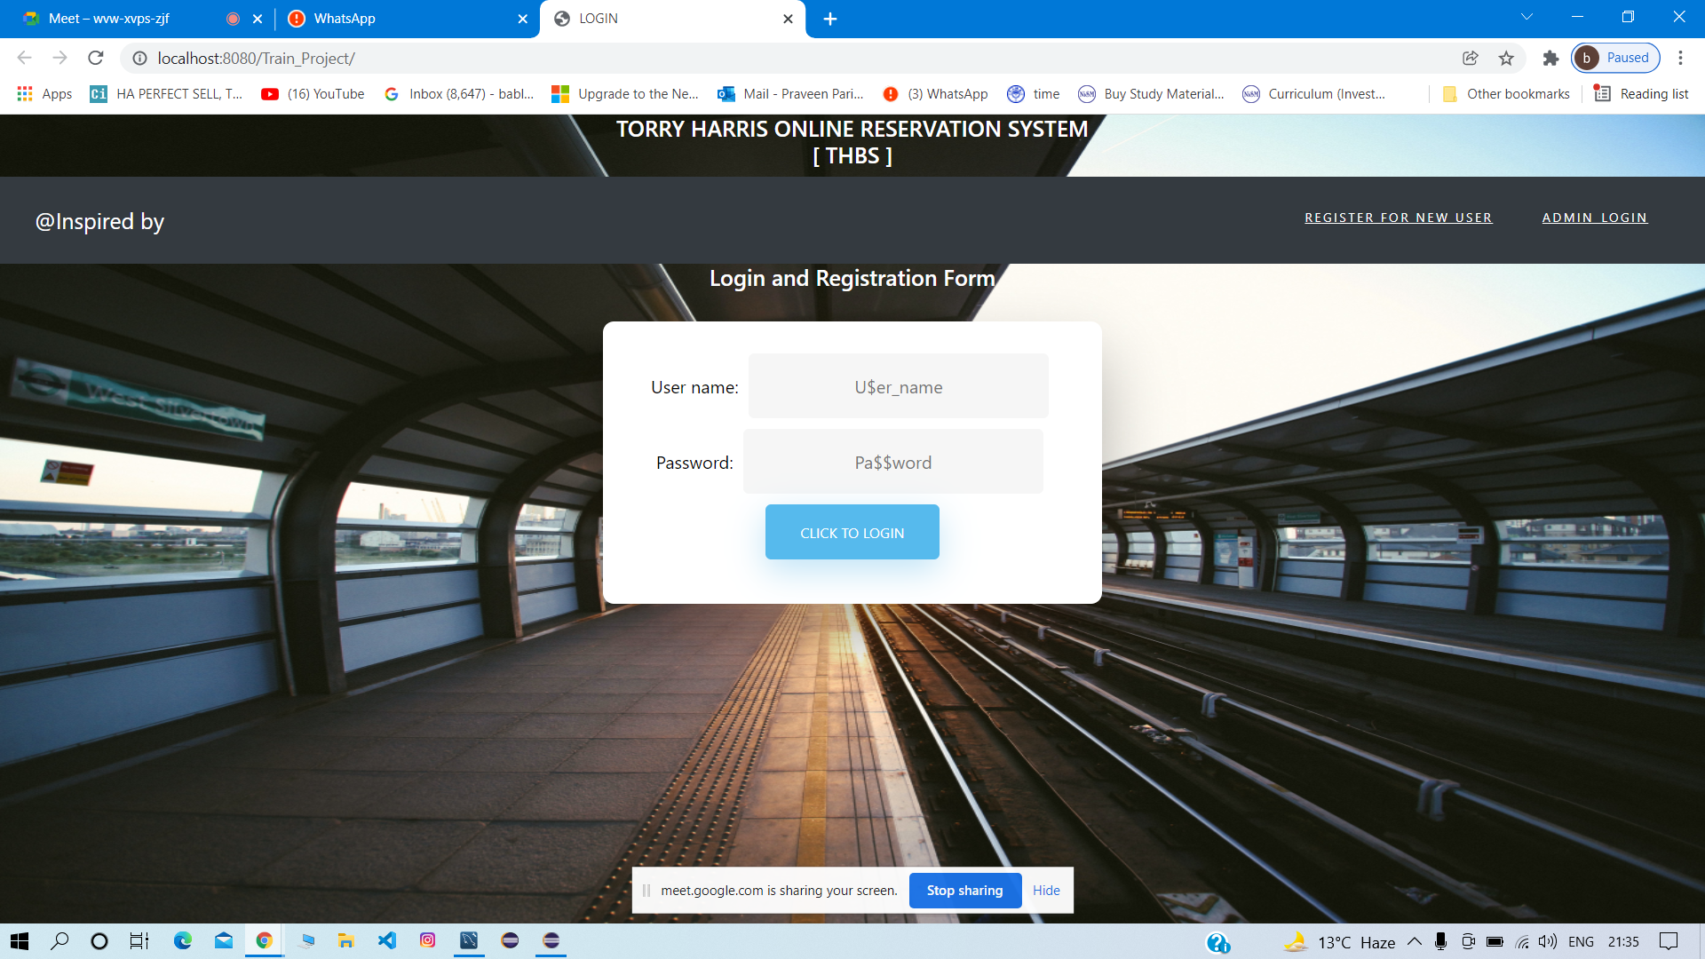

Slide 9
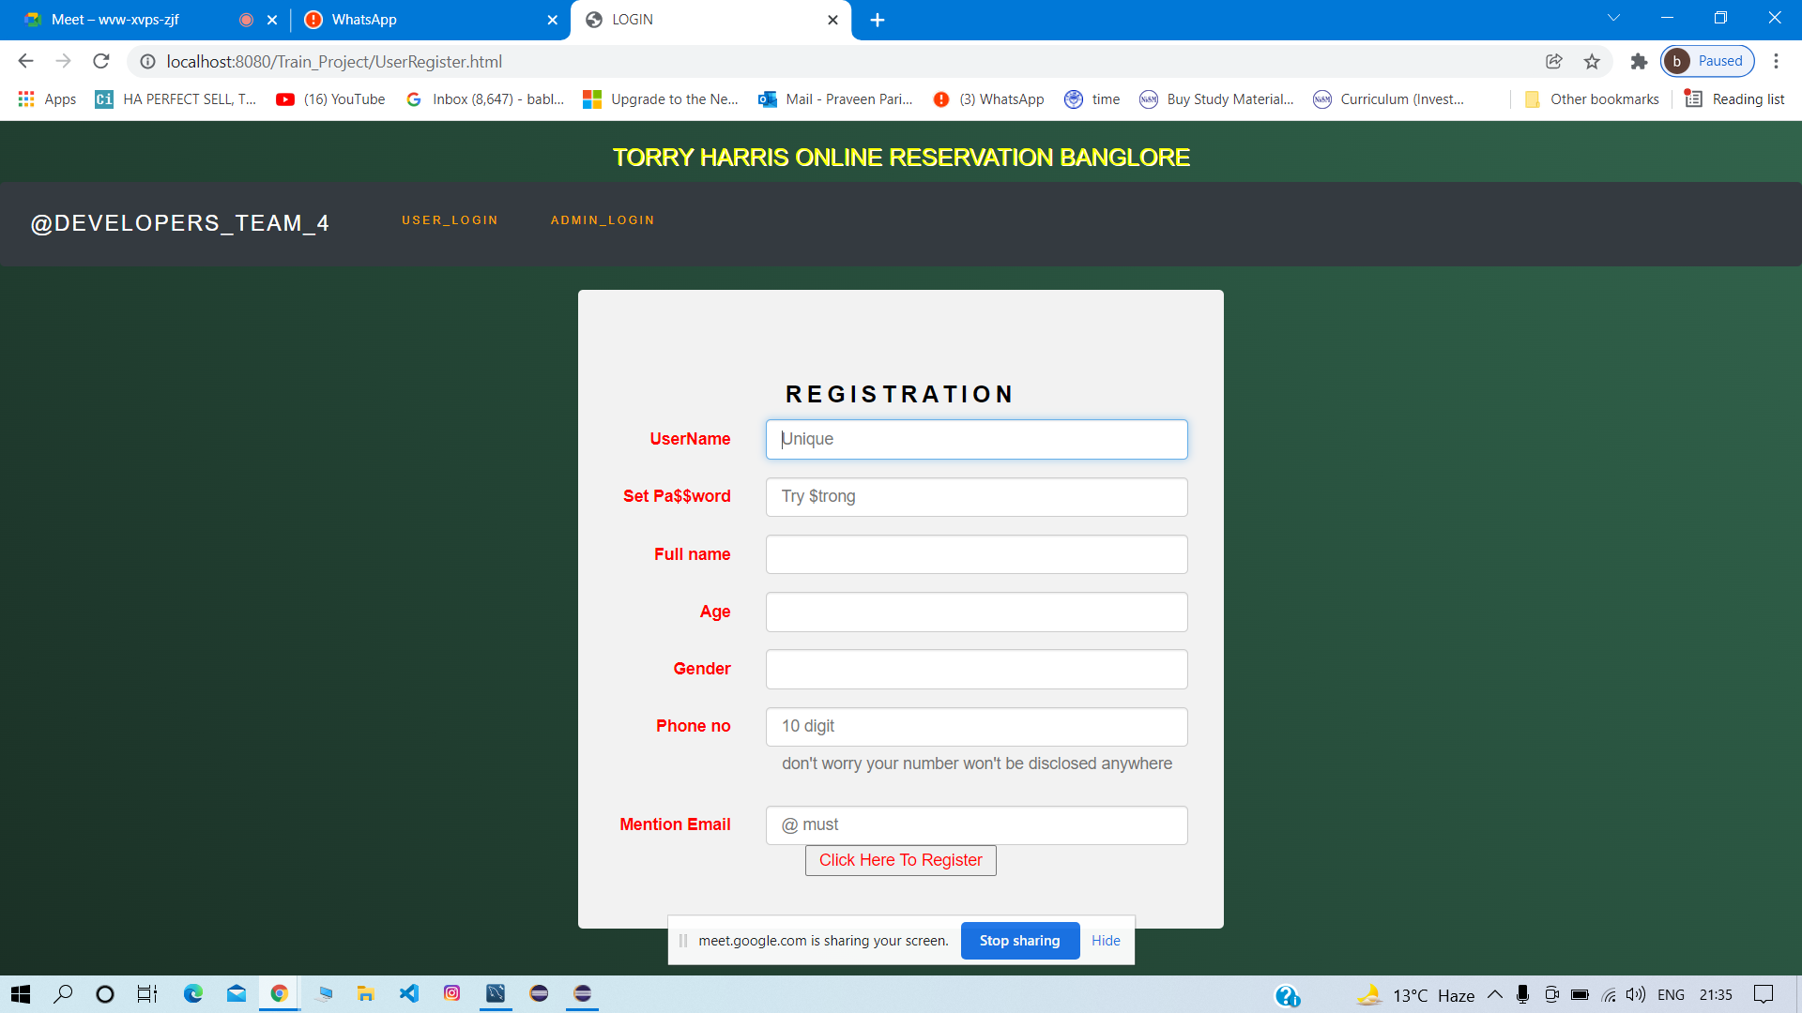

Slide 10
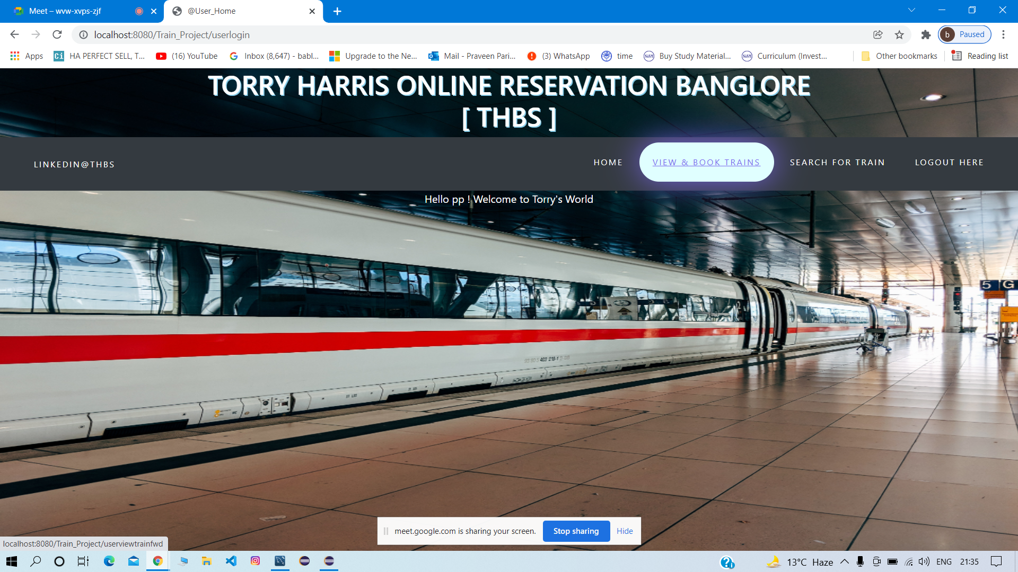

Slide 11
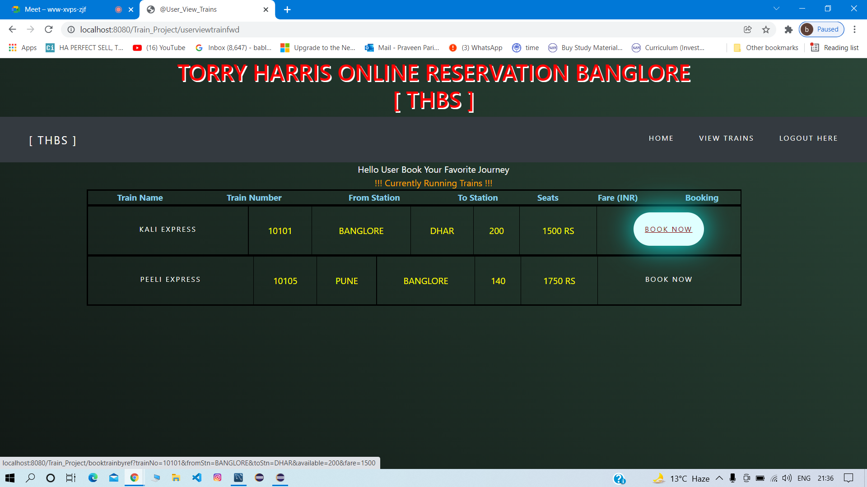

Slide 12
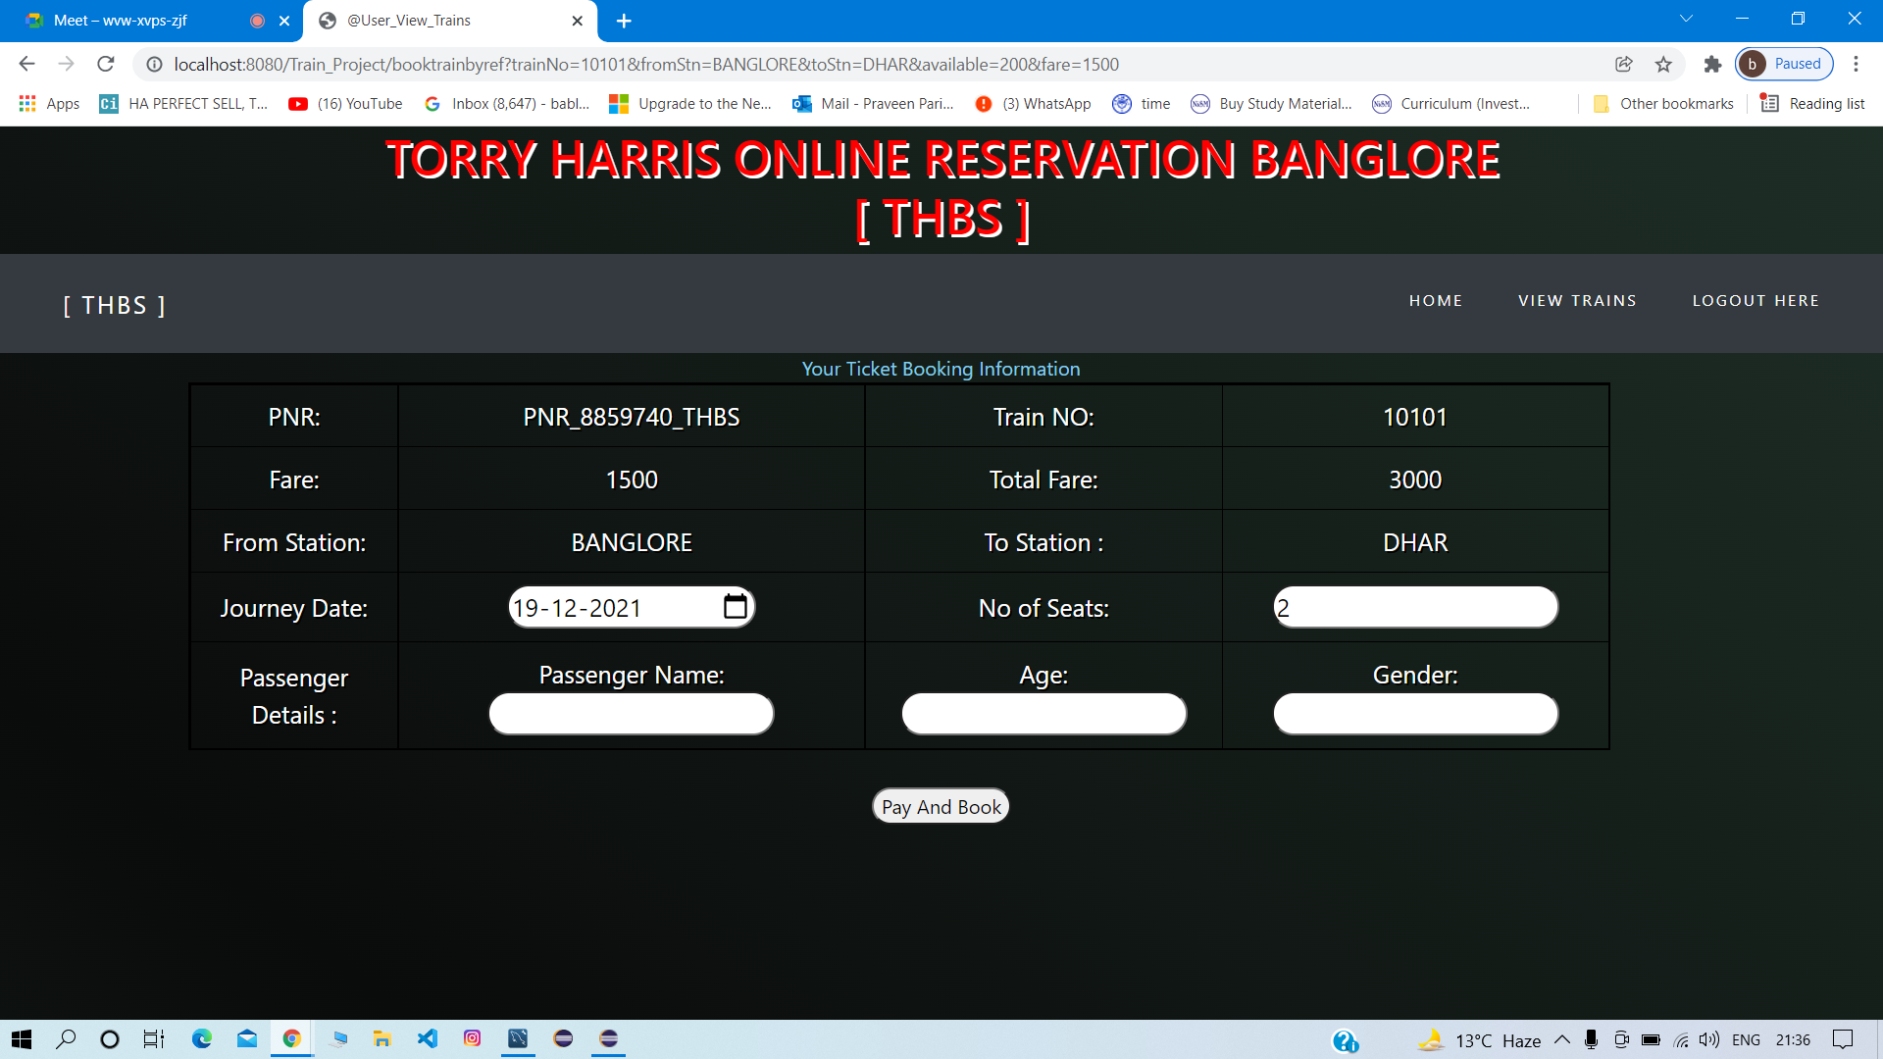

Slide 14
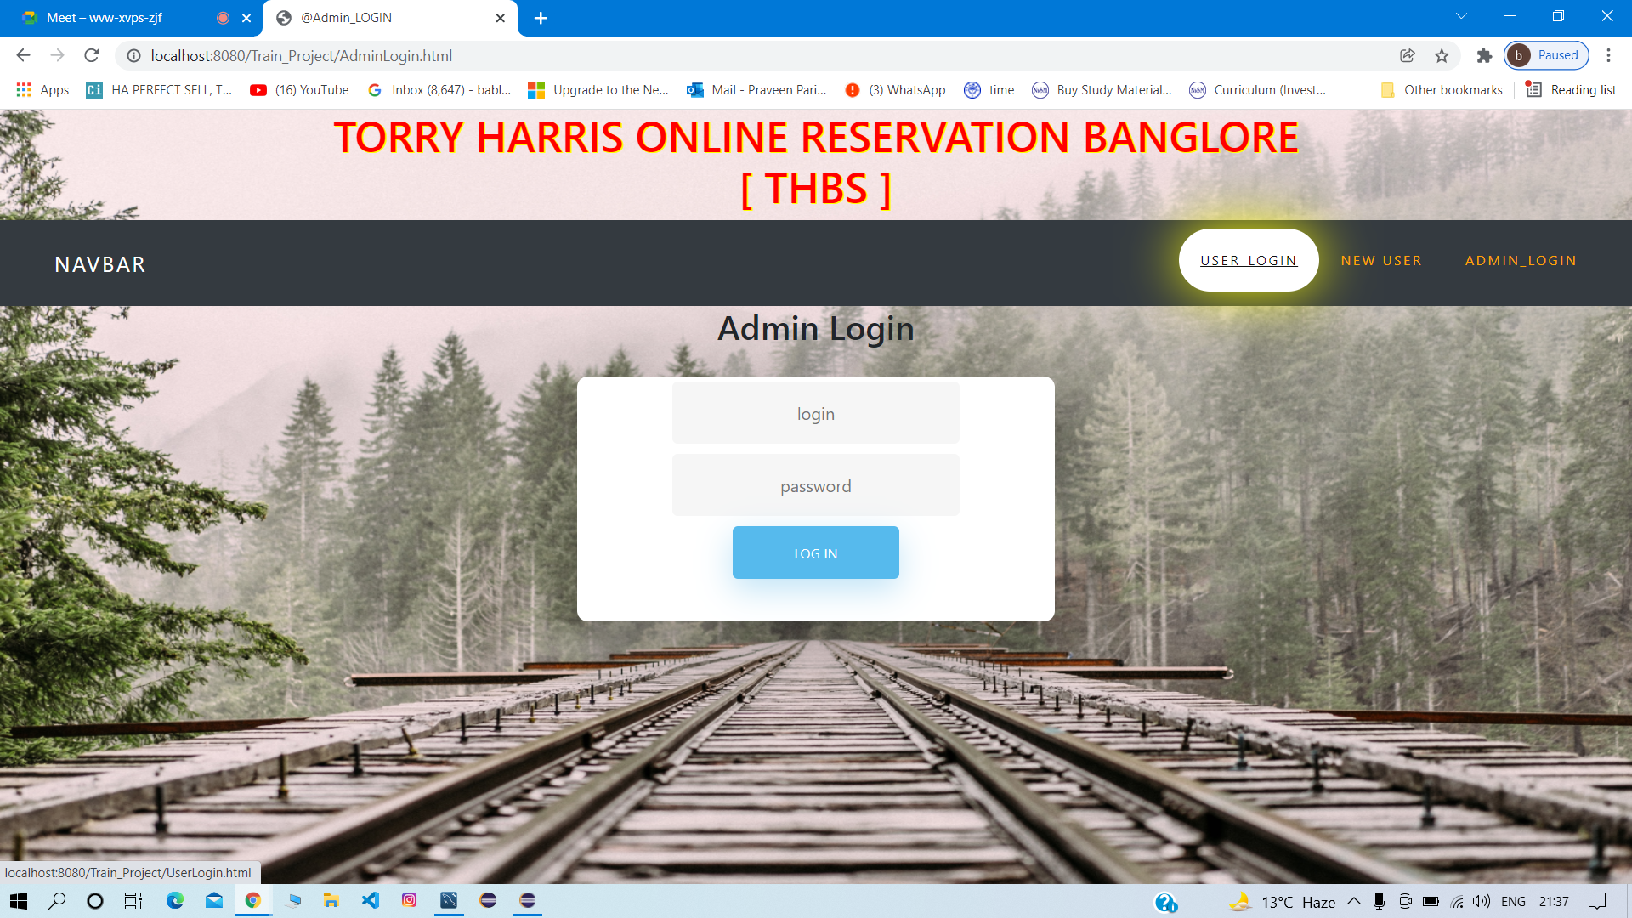

Slide 15
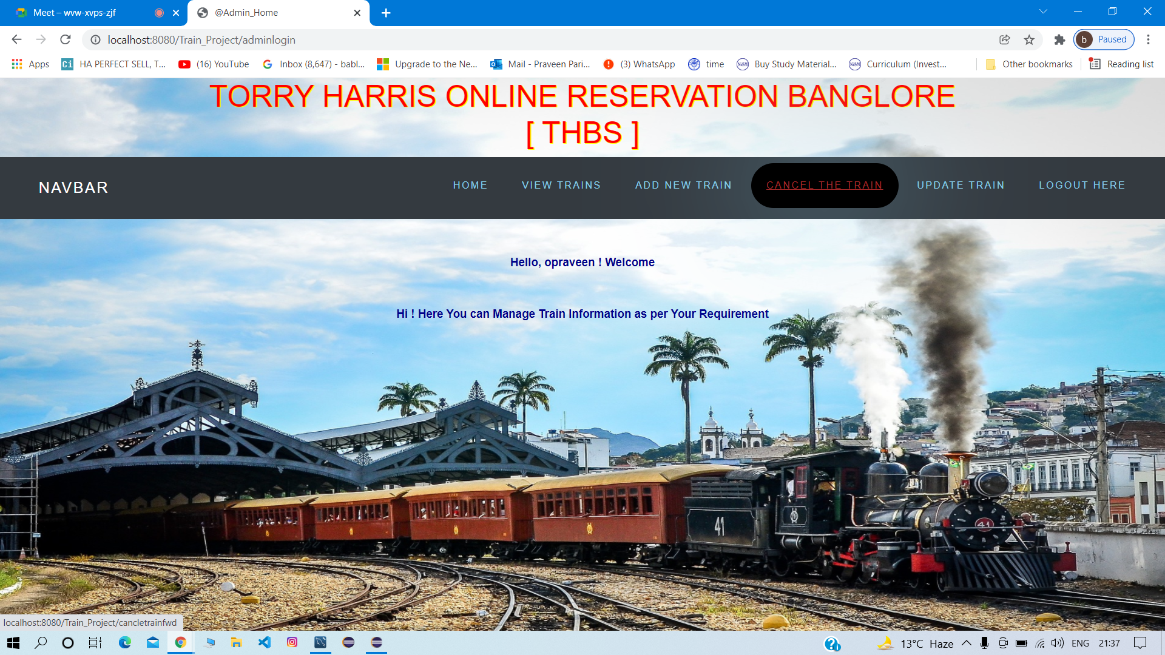

Slide 16
